Slide 1





Talbros Engineering
Tandem Axle Shafts
https://talbrosaxles.com/products/tandem-axle-shafts/

Slide 2
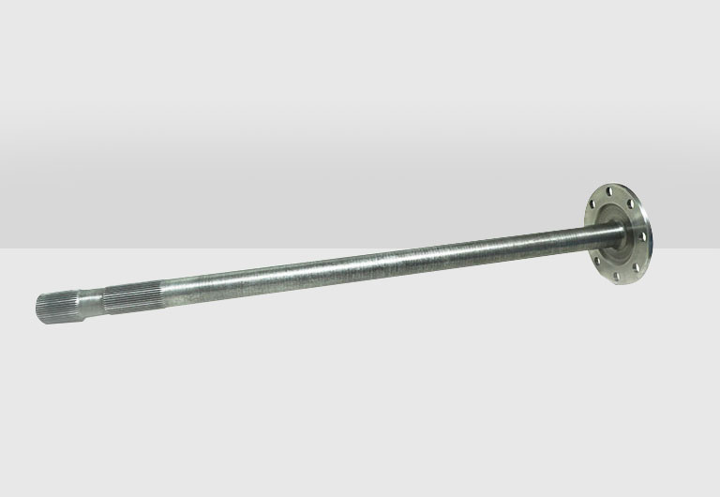
Tandem Axle Shafts
Tandem axle shafts are essential components in heavy-duty vehicles, offering durability and efficiency. Designed for tandem axles, these shafts ensure smooth torque transmission and load distribution. Talbros Engineering excels in manufacturing high-performance tandem axle shafts, catering to various vehicle applications.
For more details visit us at:-
https://talbrosaxles.com/products/tandem-axle-shafts/

Slide 3
Contact Us
Talbros Engineering
Email:-contact@vinitec.in
Address:- Plot No. 74-75-76, Sector-6 Faridabad 121006 ( Haryana)
Contact No.: +91-129-4284300
Website:- https://talbrosaxles.com/products/tandem-axle-shafts/

