Slide 1

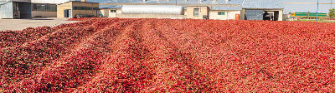

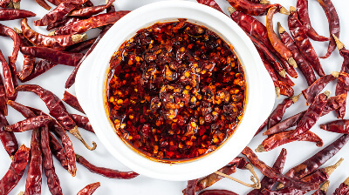
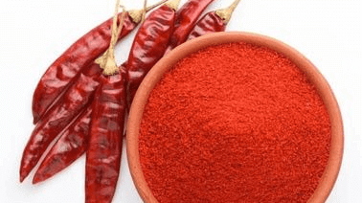
Chilli Export from India
By Agrocrops

Slide 2
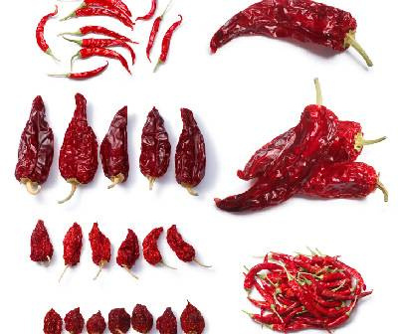
Agrocrops stands as the world's largest producer and exporter of chillies, contributing significantly to the global spice market. The Guntur region in Andhra Pradesh is renowned for its extensive chilli production and exports, offering varieties like Teja, Sannam S4, and Byadgi. Indian chillies are esteemed worldwide for their vibrant color and distinct pungency, making them a staple in numerous international cuisines. Major importers of Indian chillies include the United States, United Kingdom, United Arab Emirates, and Saudi Arabia.

Slide 3





Contact US
91 9701363424
contact@agrocrops.com
https://www.spicesindia.net/
D.No 25-16-180, 181, Mirichi Yard Road, Guntur, Andhra Pradesh, 522005

Slide 4
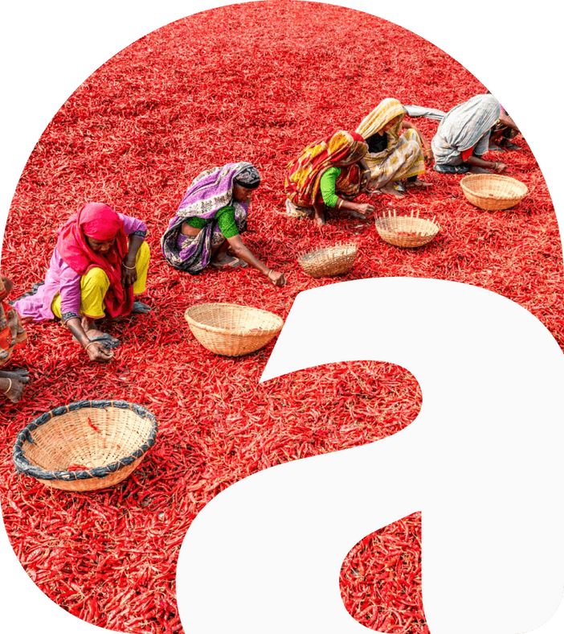
Thank
you
Visit - https://www.spicesindia.net/

