Slide 1



PINEGROVE SCHOOL
Boarding schools in Solan Himachal Pradesh
Website:-
https://pinegrove.in/location.aspx

Slide 2

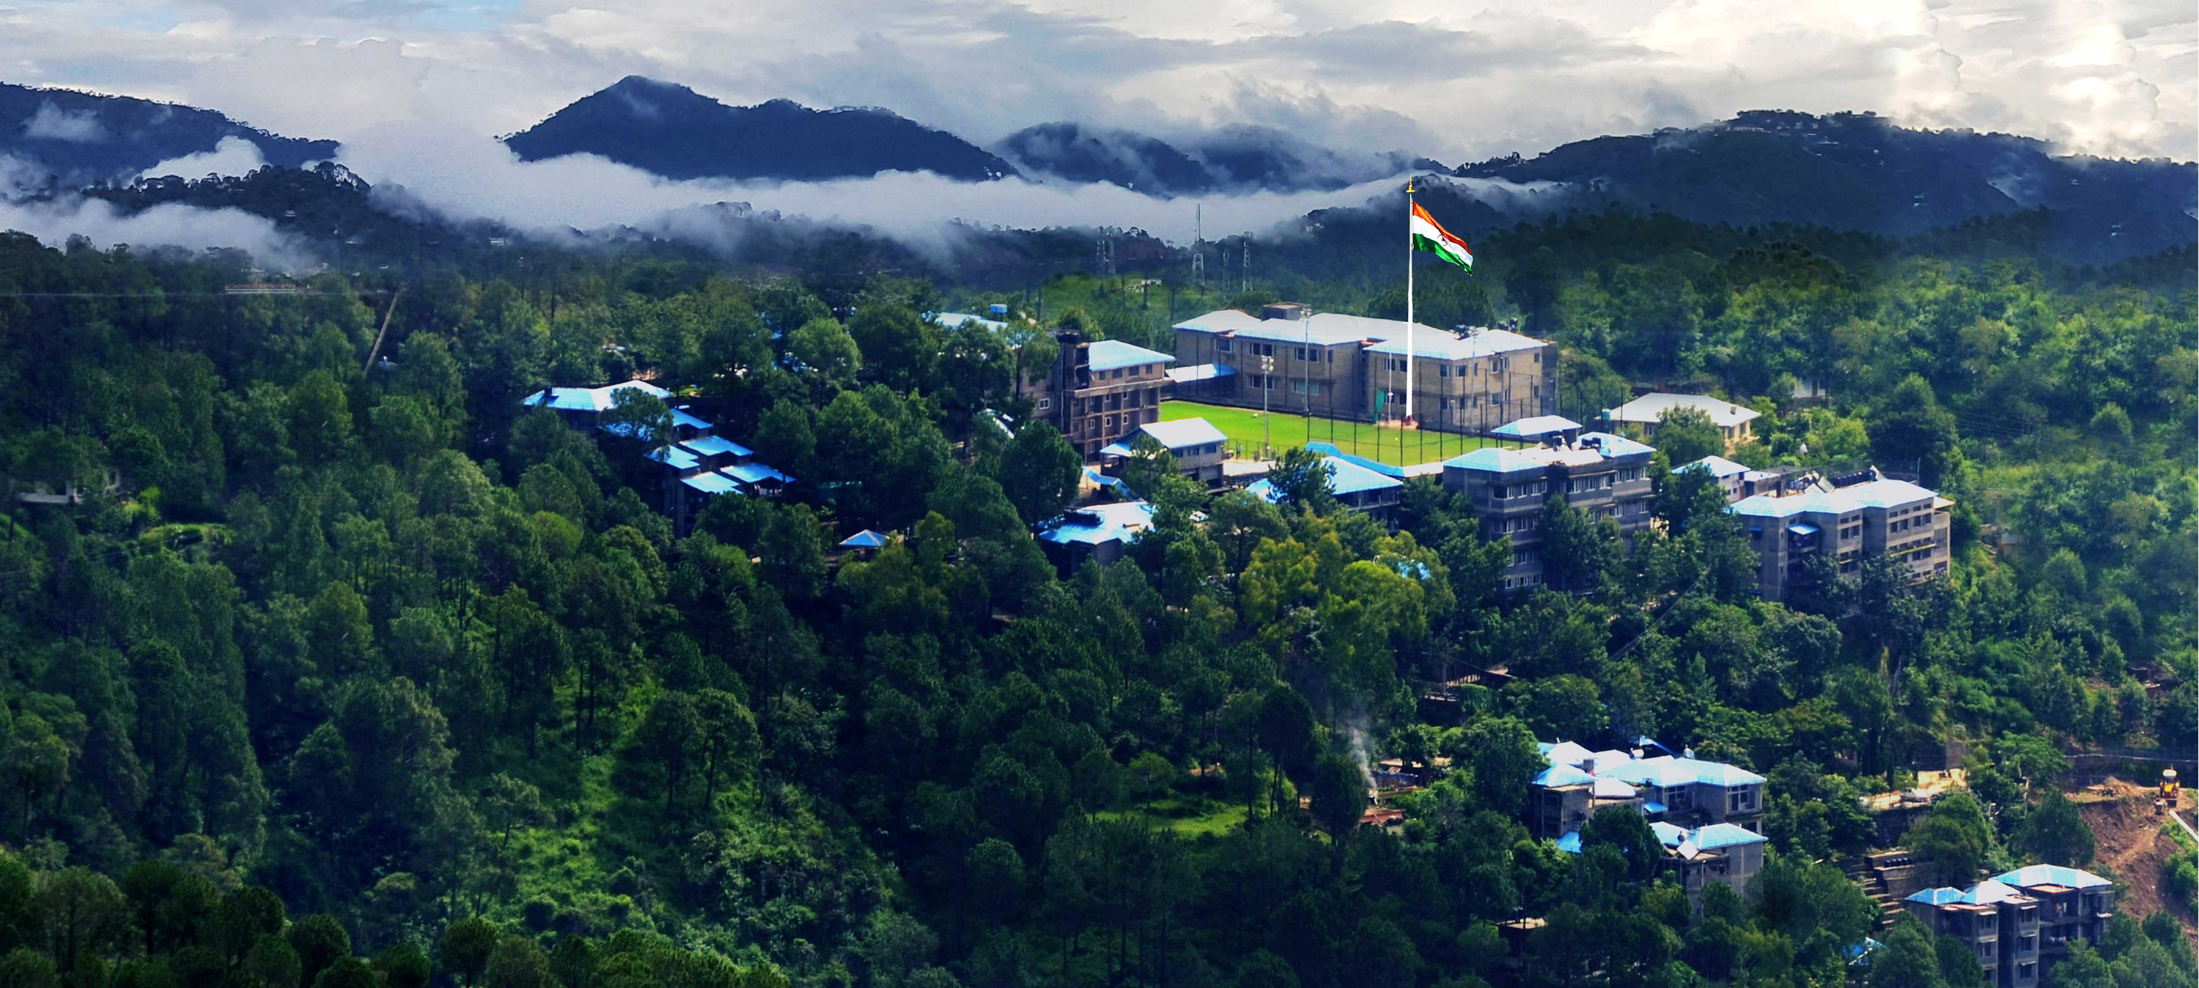
ABOUT US
Pinegrove School is among the best residential schools in India, renowned for its commitment to holistic education and excellence. Established in 1991, it is a co-educational, English-medium school affiliated with the CBSE board. Located in the picturesque Solan district of Himachal Pradesh, Pinegrove operates across two campuses: Dharampur and Subathu. These campuses are set amidst the serene Shimla Hills, providing an ideal learning environment
Website:-
https://pinegrove.in/location.aspx

Slide 3
Boarding schools in Solan Himachal Pradesh
Looking for top boarding schools in Solan, Himachal Pradesh? Pine Grove School offers an exceptional learning environment amidst the serene beauty of the Himalayan foothills. Known for its academic excellence, holistic development programs, and state-of-the-art facilities, Pine Grove School ensures every student receives a well-rounded education. With a focus on discipline, values, and personal growth, our school is the perfect choice for your child’s educational journey. Experience world-class education in a peaceful, nurturing atmosphere. Enroll now and give your child the best foundation for success at Pine Grove School, Solan.
Website:-
https://pinegrove.in/location.aspx

Slide 4
FACILITIES AT PINE GROVE SCHOOL
  Well-equipped classrooms with modern technology.
  State-of-the-art sports facilities for holistic development.
  Comfortable, secure boarding accommodations.
  Comprehensive library and research resources.
  Dedicated healthcare and counseling support.
  Focused extracurricular programs for overall growth.
Website:-
https://pinegrove.in/location.aspx

Slide 5
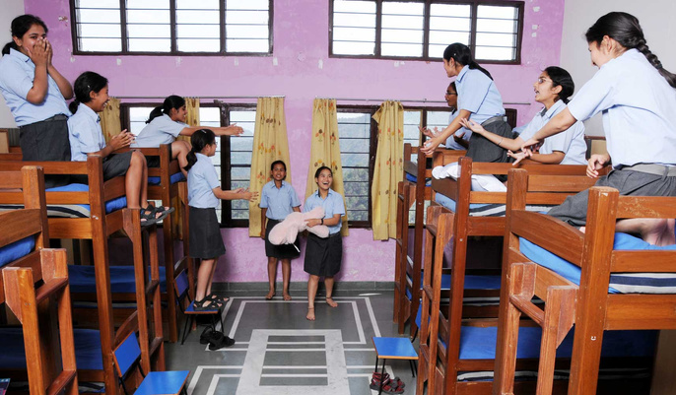
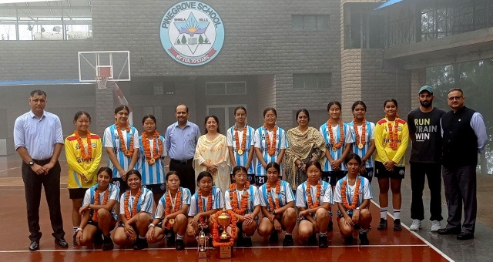
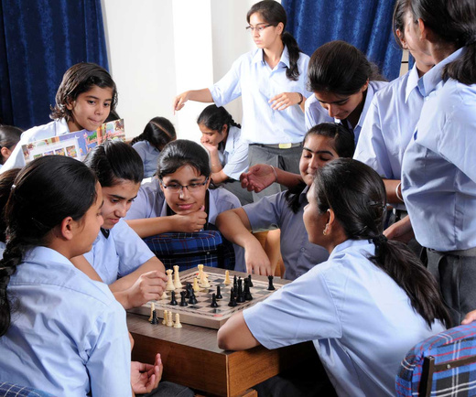
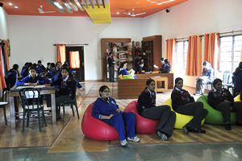
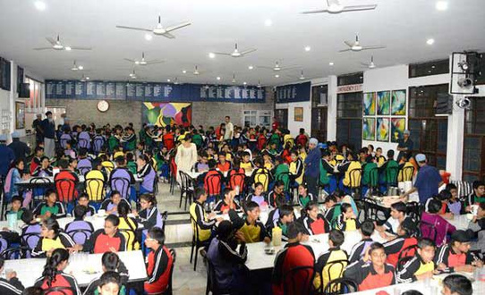
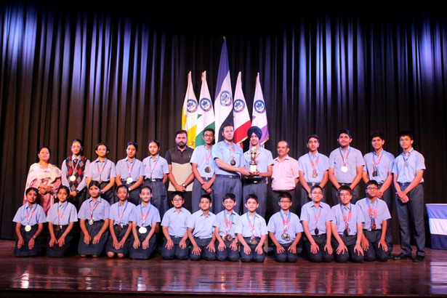
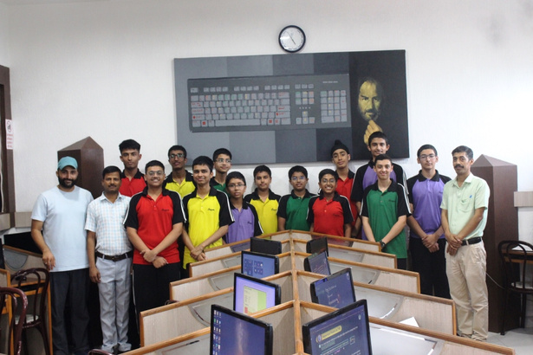
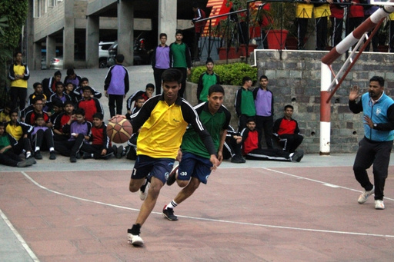
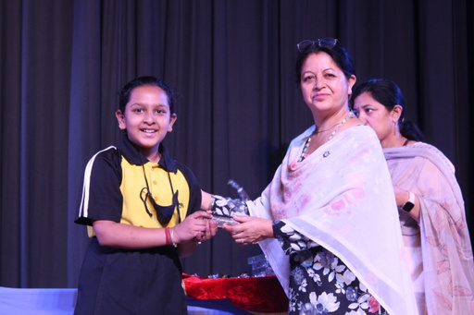
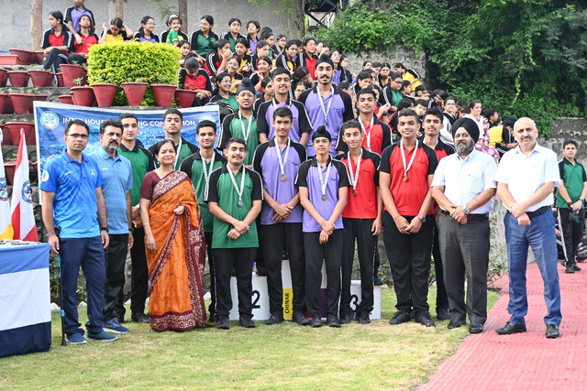
Website:-https://pinegrove.in/location.aspx

Slide 6



Website:-https://pinegrove.in/location.aspx
Thank's For Watching
Connect with us.
+91 980 5004 114
+91 980 5004 115
dharampur@pinegroveschool.com
subathu@pinegroveschool.com
Kuthar Road, Subathu 173 206 District Solan HP,India
Kasauli Road, Dharampur 173 209 District Solan HP,India

