Slide 1



PINEGROVE SCHOOL
“Best Co-Ed Boarding Schools in India”
Website:-
https://pinegrove.in/about-us.aspx

Slide 2


ABOUT US
Pinegrove School is among the best residential schools in India, renowned for its commitment to holistic education and excellence. Established in 1991, it is a co-educational, English-medium school affiliated with the CBSE board. Located in the picturesque Solan district of Himachal Pradesh, Pinegrove operates across two campuses: Dharampur and Subathu. These campuses are set amidst the serene Shimla Hills, providing an ideal learning environment
Website:-
https://pinegrove.in/about-us.aspx

Slide 3
Best Co-Ed Boarding Schools in India
Pine Grove School stands among the best co-ed boarding schools in India, offering holistic education, state-of-the-art facilities, and a nurturing environment. With a focus on academics, character development, and extracurricular activities, we prepare students for a bright future in a globalized world.
Website:-
https://pinegrove.in/about-us.aspx

Slide 4
FACILITIES AT PINE GROVE SCHOOL
  Well-equipped classrooms with modern technology.
  State-of-the-art sports facilities for holistic development.
  Comfortable, secure boarding accommodations.
  Comprehensive library and research resources.
  Dedicated healthcare and counseling support.
  Focused extracurricular programs for overall growth.
Website:-
https://pinegrove.in/

Slide 5
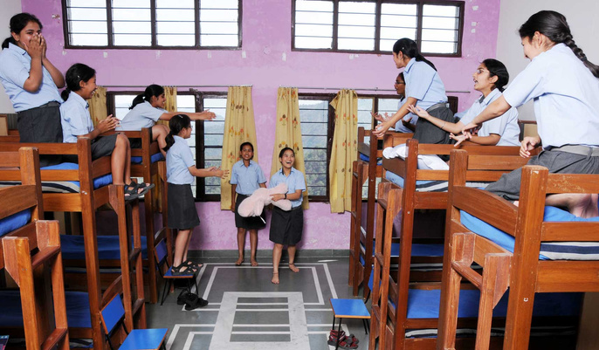
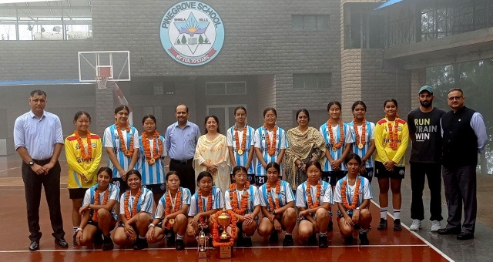

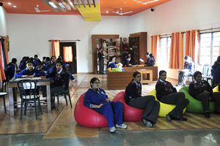
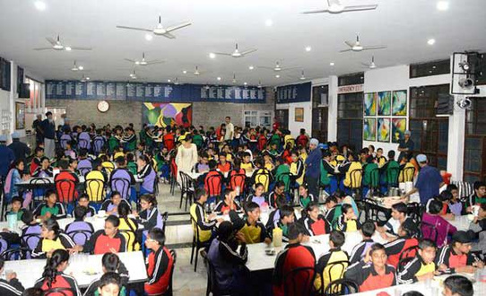
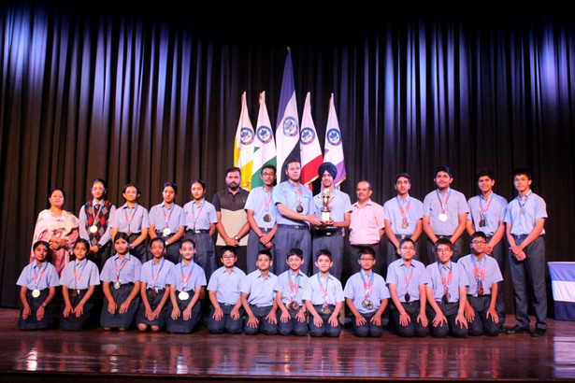
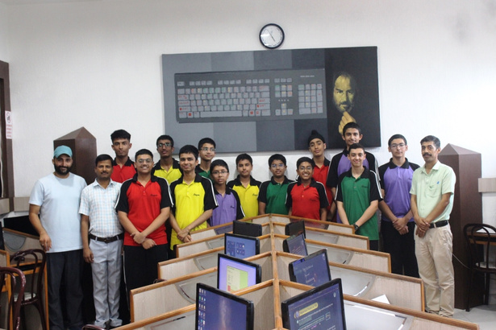

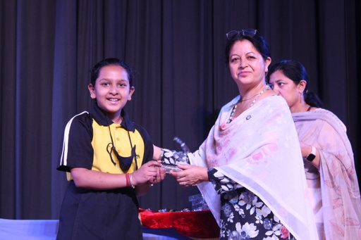
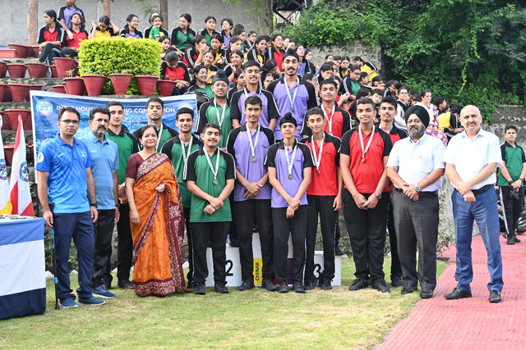
Website:-https://pinegrove.in/about-us.aspx

Slide 6



Website:-https://pinegrove.in/
Thank's For Watching
Connect with us.
+91 980 5004 114
+91 980 5004 115
dharampur@pinegroveschool.com
subathu@pinegroveschool.com
Kuthar Road, Subathu 173 206 District Solan HP,India
Kasauli Road, Dharampur 173 209 District Solan HP,India

