Slide 1


Home
Service
About Us
Contact
Imperial Weddings
“Aggarwal Marriage Bureau in Delhi”
Website
https://www.imperial.wedding/aggarwal-rishte-in-delhi-ncr-india

Slide 2

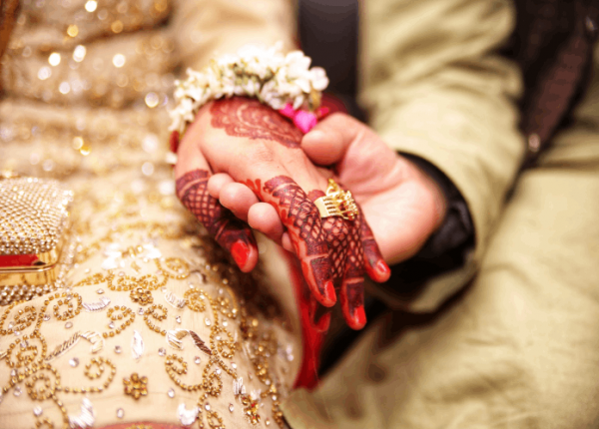
Home
Service
About Us
Contact
About us
At Imperial Wedding, we specialize in creating meaningful matrimonial connections, helping individuals find their perfect life partners across the globe. With a focus on Indian culture and traditions, we offer personalized matchmaking services to meet the diverse needs of our clients. Our dedicated team ensures each match is carefully curated, combining modern values with age-old traditions to foster lasting relationships. Whether you’re seeking a partner locally or internationally, Imperial Wedding is committed to making your journey to marriage smooth, efficient, and successful. Let us help you find your perfect match!
Website
https://www.imperial.wedding/aggarwal-rishte-in-delhi-ncr-india

Slide 3
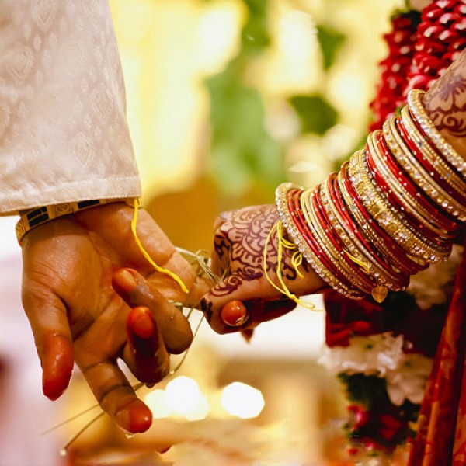
Home
Service
About Us
Contact
Aggarwal Marriage Bureau in Delhi
Looking for a reliable and personalized Aggarwal marriage bureau in Delhi? Imperial Wedding connects you with like-minded matches, blending tradition and modernity. Our expert matchmaking services ensure seamless compatibility and convenience. Whether it's day or night, find your perfect partner anytime, anywhere with Imperial Wedding—your trusted partner in creating lifelong bonds.
Website
https://www.imperial.wedding/aggarwal-rishte-in-delhi-ncr-india

Slide 4


Home
Service
About Us
Contact
Website:
https://www.imperial.wedding/aggarwal-rishte-in-delhi-ncr-india
Thank you very much
contact us :
011-40505815 9773525525
117, 1st Floor, NDM-1
Netaji Subhash Place
Pitampura, Delhi-110034
info@imperial.wedding

