Slide 1


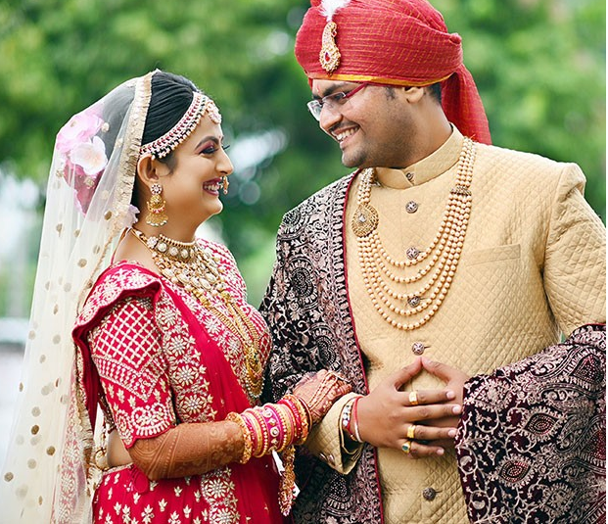

Aggarwal Marriage Bureau in Delhi
Visit - https://siddhimatrimonials.com/aggarwal-matrimonial-services-in-delhi

Slide 2



Siddhi Matrimonials the top Aggarwal Marriage Bureau in Delhi offering trusted matchmaking services for Aggarwal community, ensuring compatible matches and personalized matrimonial solutions.

Slide 3
Address -1497, 2nd floor, Kotla Mubarakpur, Opp. Oncoplus Hospital, Defence Colony, Delhi – 110003
Phone - +91 78386 86853
Website - https://siddhimatrimonials.com/aggarwal-matrimonial-services-in-delhi

Slide 4
Thank You

