Slide 1


Aloka Resort Manali
Best Resorts in Manali
Best Resorts in Manali

Slide 2
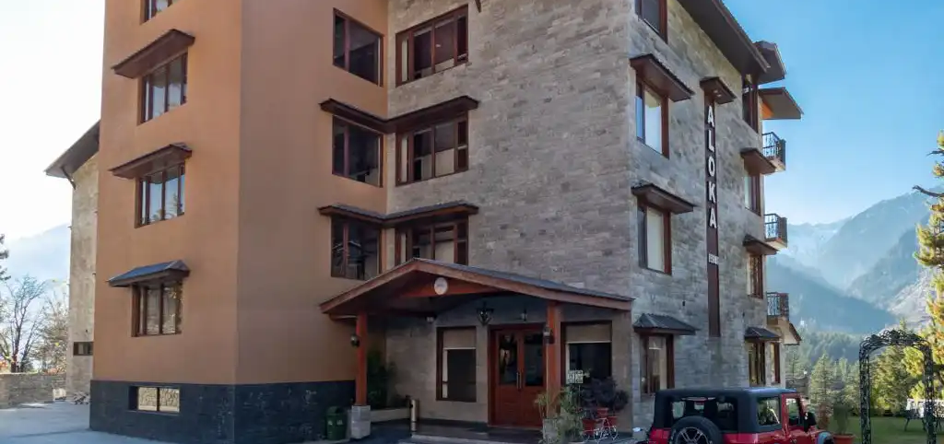

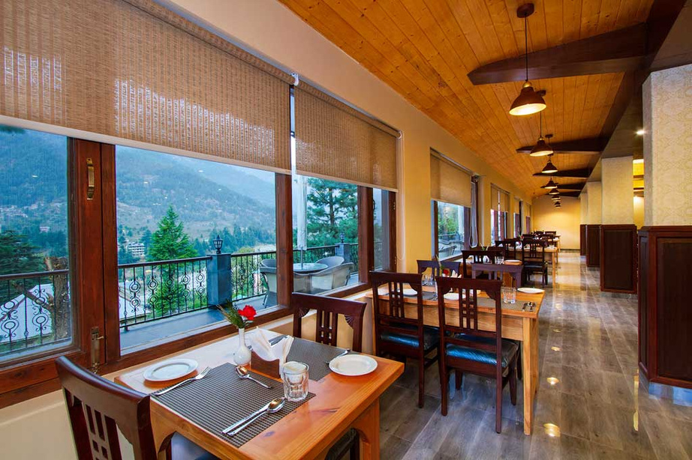
Aloka Resort in Manali is a luxurious retreat nestled in the scenic Himalayan foothills. Renowned for its modern amenities, elegant interiors, and breathtaking views, it offers a perfect blend of comfort and tranquility. With options like the Aloka Suite featuring private Jacuzzis and family-friendly deluxe rooms, it caters to every traveler's needs

Slide 3
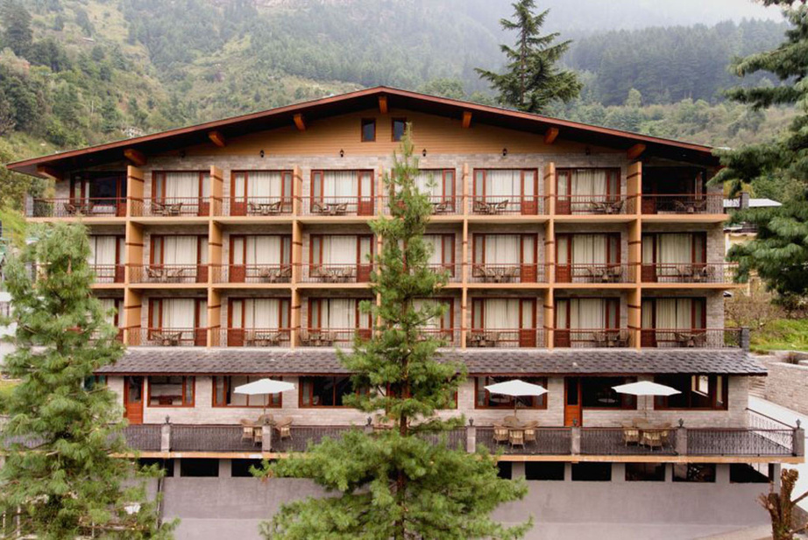
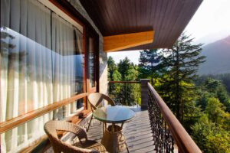
Address
Address
Chadyari, Tehsil Manali, Distt Kullu H.P, 175131, INDIA
Phone: +91 78386-09537, +91 98160-76122
Email: alokaresortmanali@gmail.com
Website - https://alokaresortmanali.com/

Slide 4


Thank You

