Slide 1





Talbros Engineering
Front Axle Shafts
https://talbrosaxles.com/products/front-axle-shafts/

Slide 2
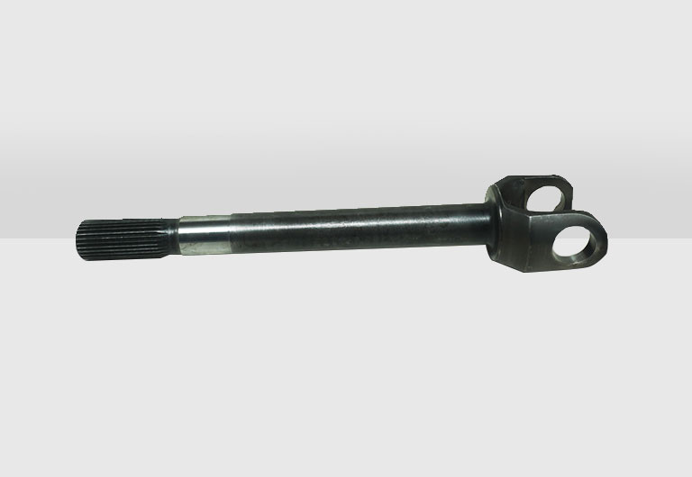
Front Axle Shafts
Front axle shafts are critical components in vehicles, ensuring efficient power transmission and smooth steering. Talbros Engineering specializes in manufacturing durable front axle shafts for various applications, including passenger, commercial, off-road, and tractor segments. Their in-house forging, heat treatment, and quality testing facilities ensure high performance, reliability, and compliance with OEM standards​
For more details visit us at:-
https://talbrosaxles.com/products/front-axle-shafts/

Slide 3
Contact Us
Talbros Engineering
Email:-contact@vinitec.in
Address:- Plot No. 74-75-76, Sector-6 Faridabad 121006 ( Haryana)
Contact No.: +91-129-4284300
Website:- https://talbrosaxles.com/products/front-axle-shafts/

