Slide 1


Chilli Export from India
By Agrocrops
https://www.spicesindia.net/

Slide 2
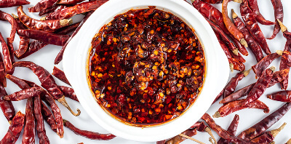
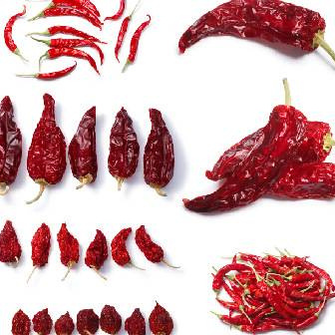
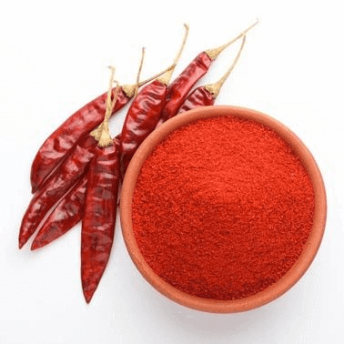
Agrocrops offers premium, authentic Indian spices and seasonings, delivering rich flavors worldwide. Explore a curated selection of pure, high-quality spices, carefully sourced to elevate your culinary experience.

Slide 3
Address- D.No 25-16-180, 181,
Mirichi Yard Road, Guntur, Andhra Pradesh, 522005
Email Us - contact@agrocrops.com
Call us - +91 97013 63424
Visit- https://www.spicesindia.net/

Slide 4

Thanks

