Slide 1



PINEGROVE SCHOOL
“Best Residential Schools in India”
Website:-
https://pinegrove.in/about-us.aspx

Slide 2

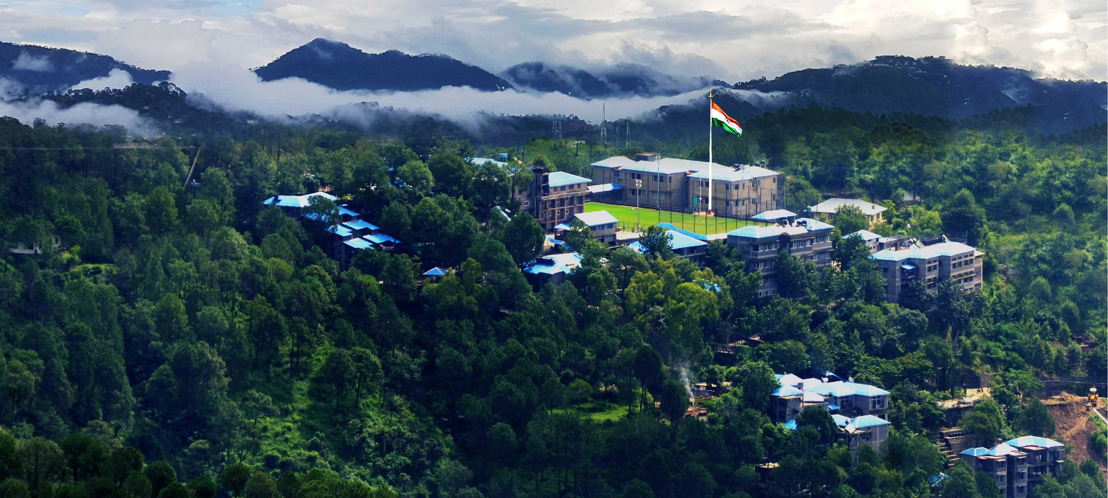
ABOUT US
Pinegrove School is among the best residential schools in India, renowned for its commitment to holistic education and excellence. Established in 1991, it is a co-educational, English-medium school affiliated with the CBSE board. Located in the picturesque Solan district of Himachal Pradesh, Pinegrove operates across two campuses: Dharampur and Subathu. These campuses are set amidst the serene Shimla Hills, providing an ideal learning environment
Website:-
https://pinegrove.in/about-us.aspx

Slide 3
Best Residential Schools in India
Pinegrove School is one of the best residential schools in India, offering a nurturing environment and holistic education. Our expert faculty, state-of-the-art facilities, and commitment to academic excellence make us a preferred choice for students seeking a top-tier education and personal growth in a residential setting.
Website:-
https://pinegrove.in/about-us.aspx

Slide 4
KEY FEATURES OF PINEGROVE SCHOOL INCLUDE
  Academic Excellence: The school offers a rigorous CBSE curriculum and emphasizes value-based education to prepare students for global challenges
  State-of-the-Art Facilities: Facilities include modern classrooms, sports grounds, and boarding amenities. Both vegetarian and non-vegetarian meals are provided, ensuring a balanced diet.
  Co-Curricular Focus: Students participate in diverse activities such as sports (football, cricket, hockey), music, and the arts. The school also prioritizes discipline, moral values, and personality development
  Global Affiliations: Pinegrove is a member of prestigious organizations like the Indian Public Schools' Conference (IPSC) and the Round Square, enhancing its international outlook.
Website:-
https://pinegrove.in/about-us.aspx

Slide 5



Website:-https://pinegrove.in/about-us.aspx
Thank's For Watching
Connect with us.
+91 980 5004 114
+91 980 5004 115
dharampur@pinegroveschool.com
subathu@pinegroveschool.com
Kuthar Road, Subathu 173 206 District Solan HP,India
Kasauli Road, Dharampur 173 209 District Solan HP,India

