Slide 1

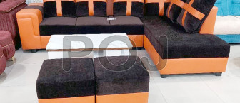
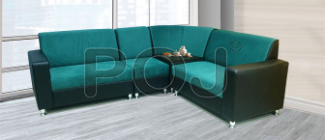
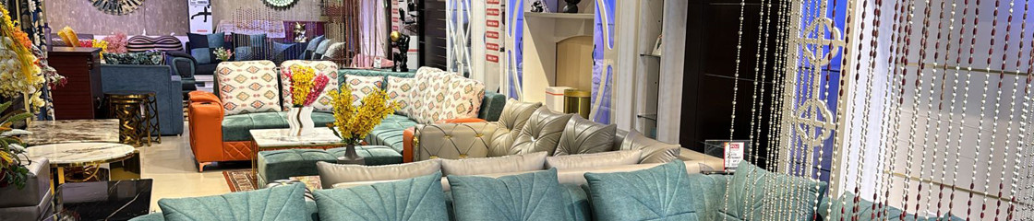
POJ Furniture
Buy Furniture for Your Living Room Online

Slide 2
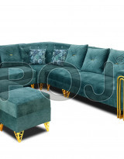
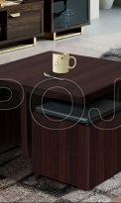

Upgrade your home with premium living room furniture from POJ Furniture. Explore a selection of chic sofas, versatile wall units, sophisticated center tables, and more to complement any décor. Enjoy flexible payment plans and speedy delivery, making it simple to Buy Furniture for Your Living Room Online while staying within budget. Discover a variety of designs crafted for comfort, functionality, and style, ideal for living rooms of all sizes.

Slide 3


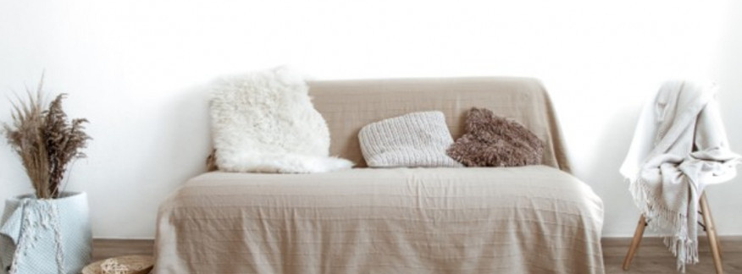
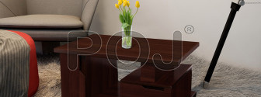
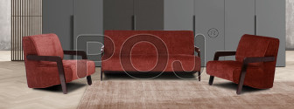
Thank You
Visit - https://www.pojfurniture.com/products/living-room-furniture

