Slide 1





Talbros Engineering
Front Axle Shafts
https://talbrosaxles.com/products/front-axle-shafts/

Slide 2
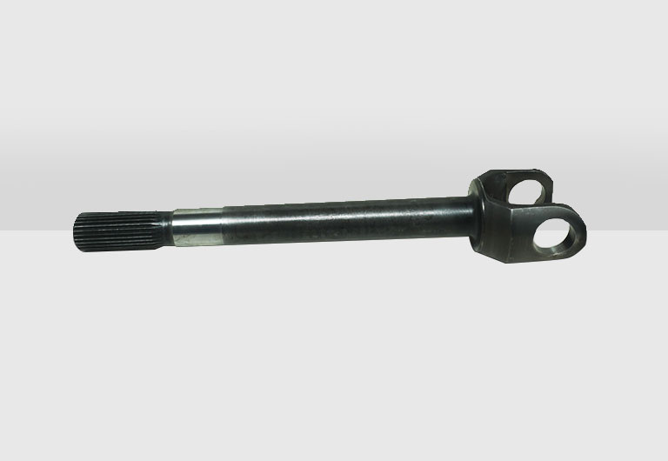
Front Axle Shafts
Front axle shafts are crucial components in vehicle drivetrain systems, transferring power from the differential to the wheels. Talbros Axles offers a range of high-quality front axle shafts designed for durability and performance. Engineered to withstand demanding conditions, these shafts enhance vehicle stability and handling, ensuring a smooth driving experience. Discover more about their innovative designs and applications at Talbros Axles.
For more details visit us at:-
https://talbrosaxles.com/products/front-axle-shafts/

Slide 3
Contact Us
Talbros Engineering
Email:-contact@vinitec.in
Address:- Plot No. 74-75-76, Sector-6 Faridabad 121006 ( Haryana)
Contact No.: +91-129-4284300
Website:- https://talbrosaxles.com/products/front-axle-shafts/

