Slide 1
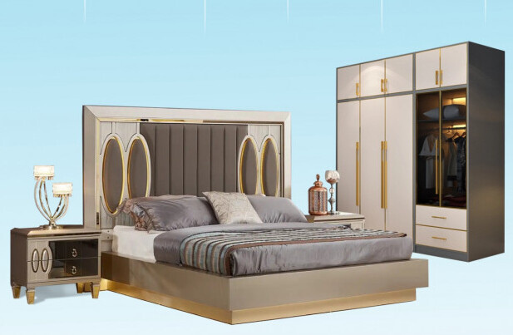

POJ FURNITURE

Slide 2


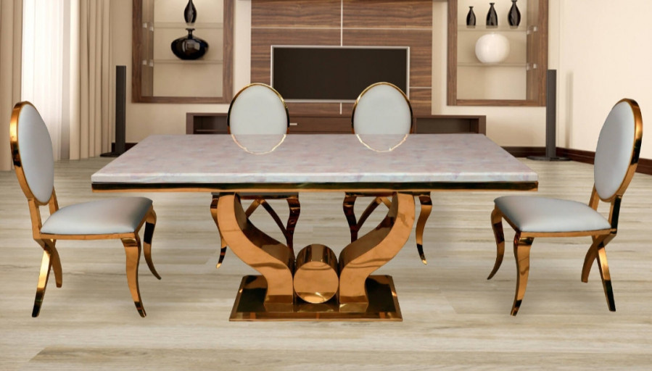
When you buy furniture online from POJ Furniture, you get access to a vast range of high-quality, stylish pieces for every room. The website offers a seamless shopping experience, featuring modern designs, durable materials, and affordable prices. Whether you're looking for sofas, beds, dining tables, or office furniture, POJ Furniture provides a variety of options to suit different tastes and spaces. Detailed product descriptions, images, and easy navigation make selecting the perfect furniture simple. Enjoy the convenience of browsing from home with quick delivery and excellent customer support to ensure a satisfying purchase.

Slide 3
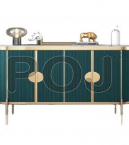
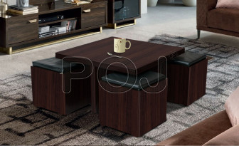
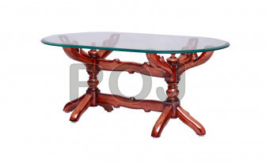
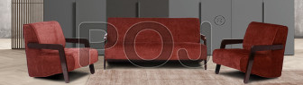
Buy Furniture Online
Visit - https://www.pojfurniture.com/

Slide 4
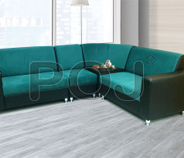
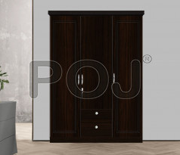
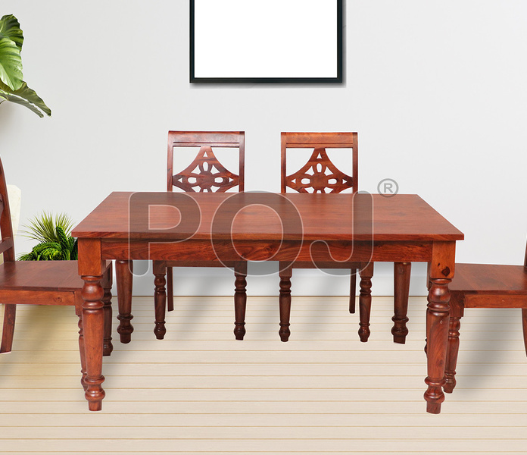

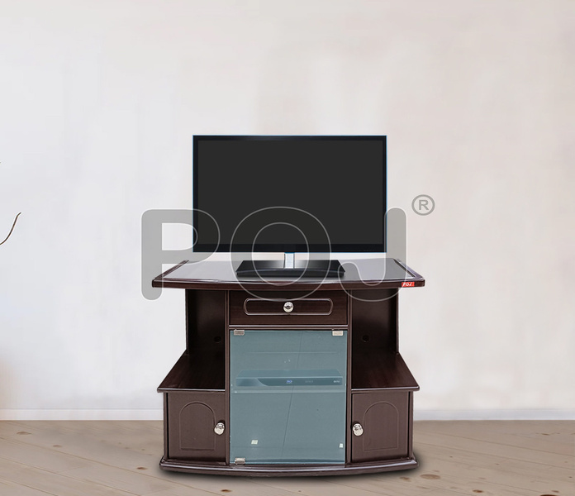
THANK YOU
https://www.pojfurniture.com/

