Slide 1


Aloka Resort Manali
Luxury Resorts in Kullu Manali

Slide 2

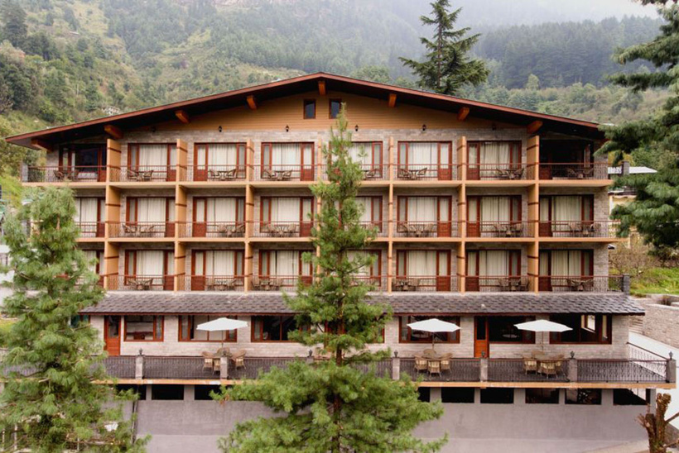

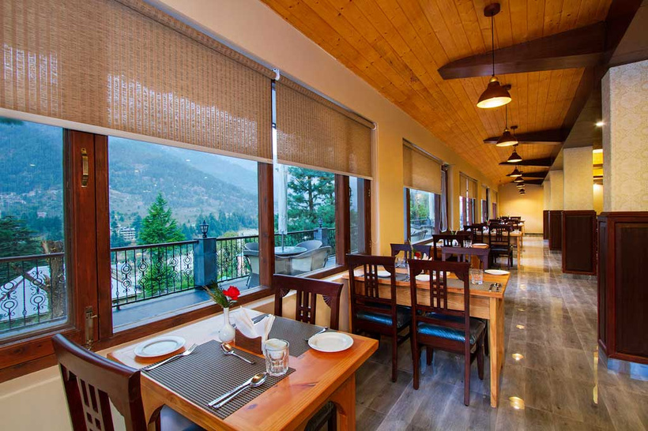
Luxury resorts in Kullu Manali, such as Aloka Resort Manali, offer an unmatched blend of comfort, serenity, and scenic beauty. Nestled in the heart of the Himalayas, these resorts provide panoramic views of snow-capped mountains and lush valleys. Guests can indulge in modern amenities, luxurious accommodations, and gourmet dining, all while being surrounded by nature. Ideal for a peaceful retreat or a romantic getaway, resorts like Aloka combine luxury with nature, ensuring a rejuvenating experience in the picturesque region of Kullu Manali

Slide 3

Address
Address
Chadyari, Tehsil Manali, Distt Kullu H.P, 175131, INDIA
Phone: +91 78386-09537, +91 98160-76122
Email: alokaresortmanali@gmail.com
Website - https://alokaresortmanali.com/

Slide 4
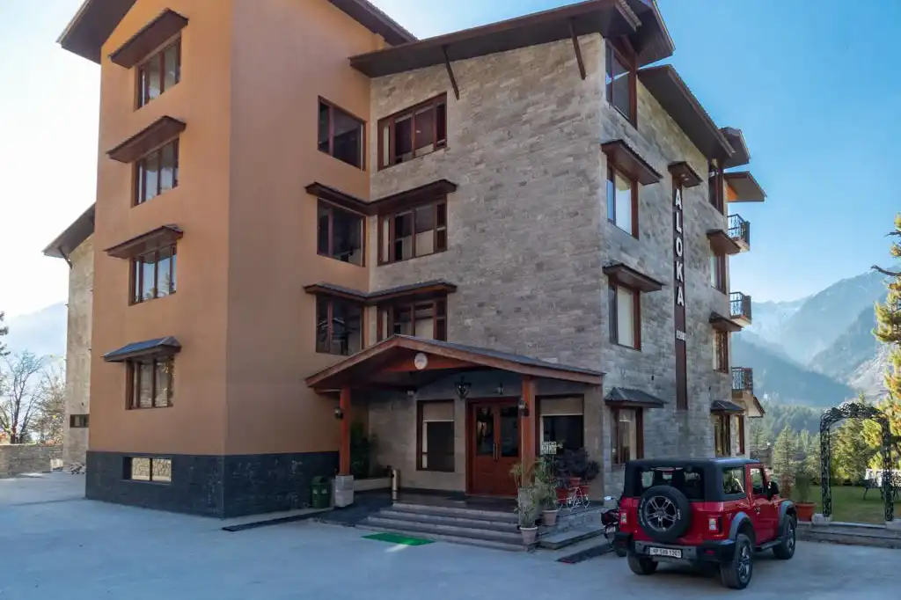
Thank You
VISIT - HTTPS://ALOKARESORTMANALI.COM/

