Slide 1

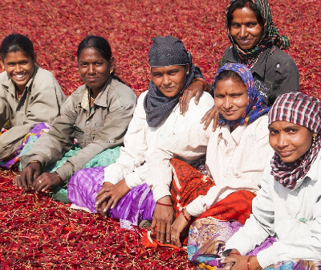

Agrocrops
Visit - https://www.spicesindia.net/

Slide 2
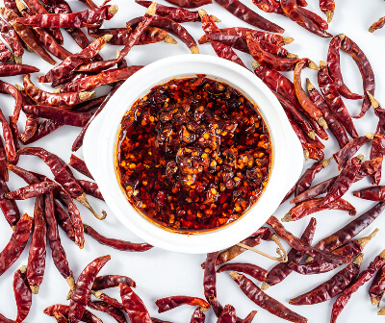
Indian Dry Red Chilli Exporters, like those featured on Agrocrops, are known for supplying high-quality chillies to international markets. India is one of the largest producers and exporters of dry red chillies, offering various varieties such as Guntur, Byadgi, and Sannam. These exporters ensure that their chillies meet global quality standards, providing products that are rich in flavor, color, and pungency. Spices India emphasizes sustainable sourcing from the best farms, using advanced processing techniques to maintain freshness and flavor. With a strong supply chain and commitment to quality, they cater to diverse culinary needs worldwide.

Slide 3
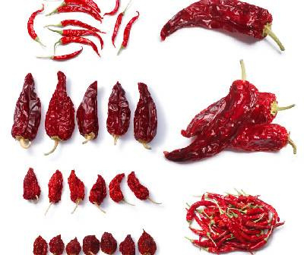





Contact US
91 9701363424
contact@agrocrops.com
https://www.spicesindia.net/
D.No 25-16-180, 181, Mirichi Yard Road, Guntur, Andhra Pradesh, 522005

Slide 4
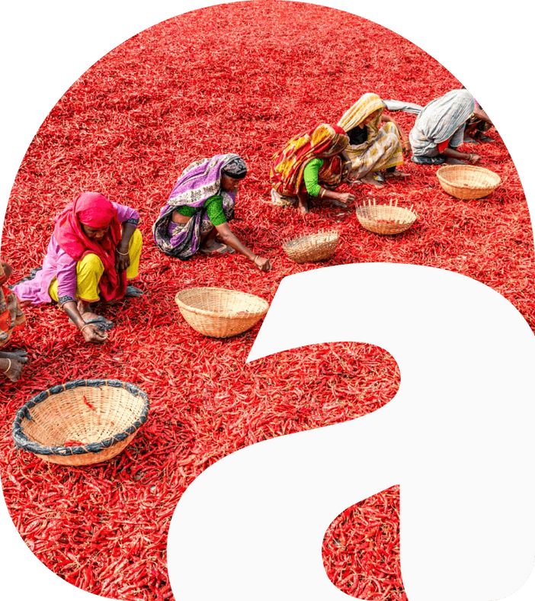
Thank
you
Visit - https://www.spicesindia.net/

