Slide 1




Home
Service
About Us
Contact
“Coffee Franchise in Chennai”
https://sutocafe.com/coffee-cafe-franchise-in-chennai/

Slide 2


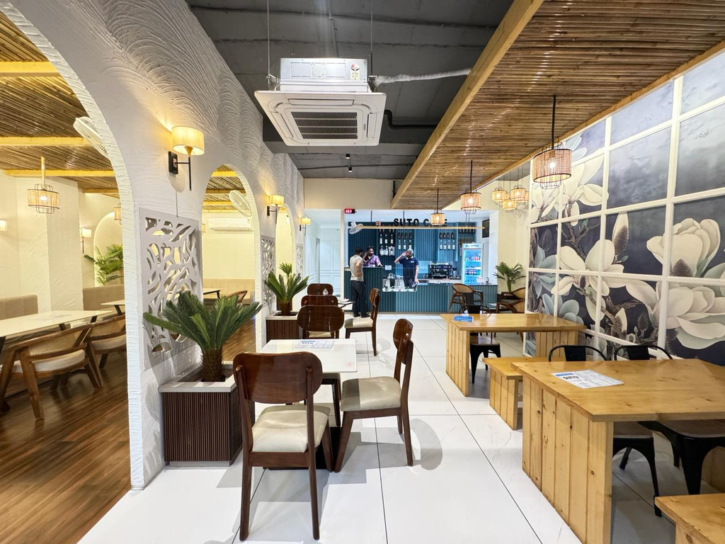
Home
Service
About Us
Contact
About Us
At Suto Cafe, we craft exceptional coffee experiences with a focus on quality and innovation. Our franchise provides a unique blend of great service and delectable menu options. Join us in bringing the best coffee to communities and thriving with a brand dedicated to excellence.
https://sutocafe.com/coffee-cafe-franchise-in-chennai/

Slide 3

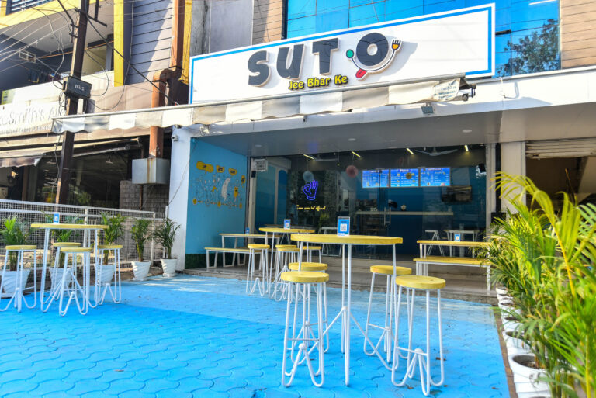
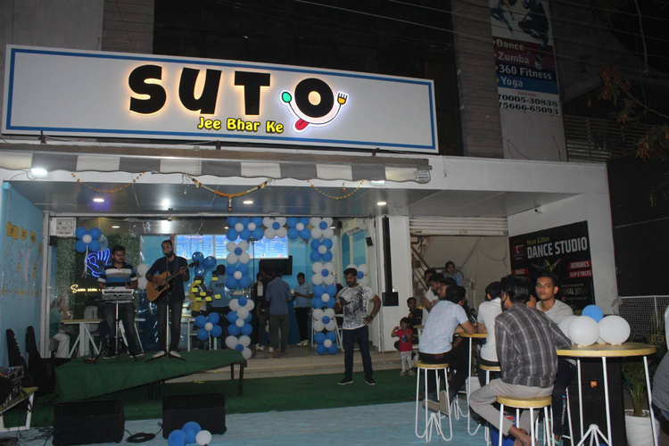
Home
Service
About Us
Contact
Coffee Franchise in Chennai
Explore the thriving opportunity of a coffee franchise in Chennai with Suto Cafe. Our brand combines quality coffee, innovative recipes, and a welcoming atmosphere, ensuring a unique experience for customers. Benefit from comprehensive support, including training and marketing strategies, to help your franchise flourish in a competitive market. Join us in redefining coffee culture!
https://sutocafe.com/coffee-cafe-franchise-in-chennai/

Slide 4



Home
Service
About Us
Contact
Our Contact
+91 7880128851
https://sutocafe.com/coffee-cafe-franchise-in-chennai/
franchise@sutocafe.com
SICA School Rd, AG Sector, Scheme No 54, Indore, Madhya Pradesh 452010

