Slide 1




Home
Service
About Us
Contact
https://sutocafe.com/

Slide 2


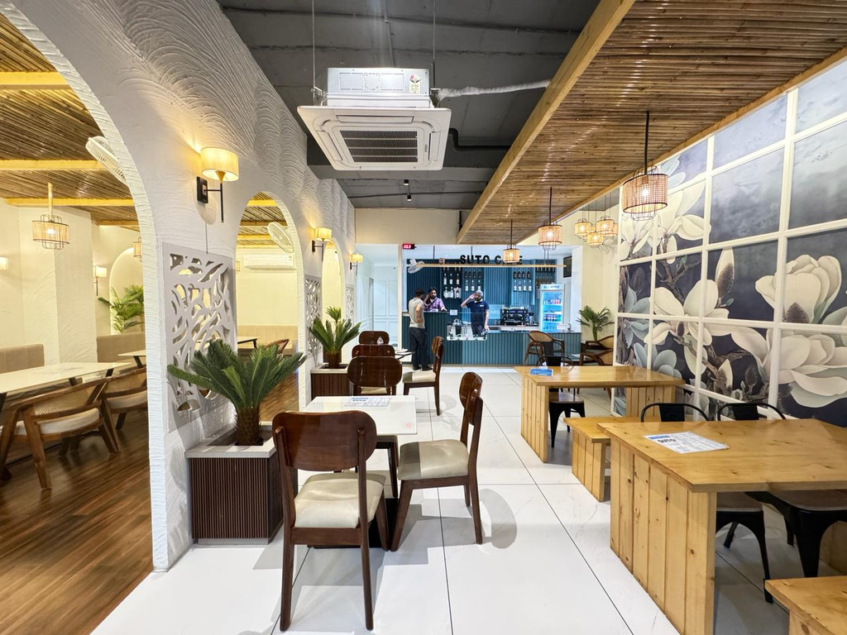
Home
Service
About Us
Contact
About Us
At Suto Cafe, we craft exceptional coffee experiences with a focus on quality and innovation. Our franchise provides a unique blend of great service and delectable menu options. Join us in bringing the best coffee to communities and thriving with a brand dedicated to excellence.
https://sutocafe.com/

Slide 3

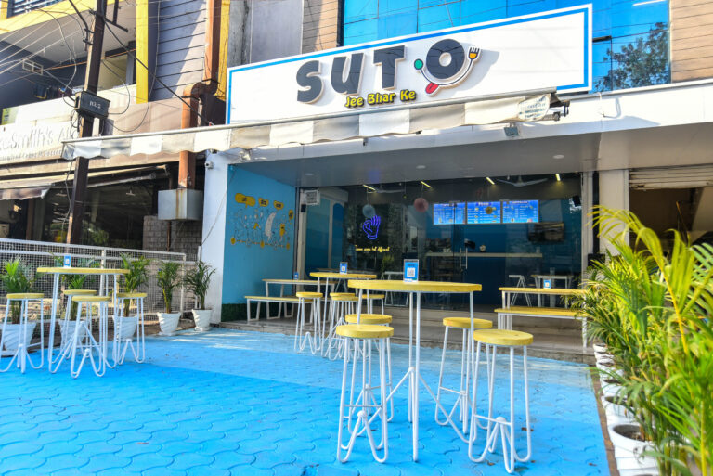
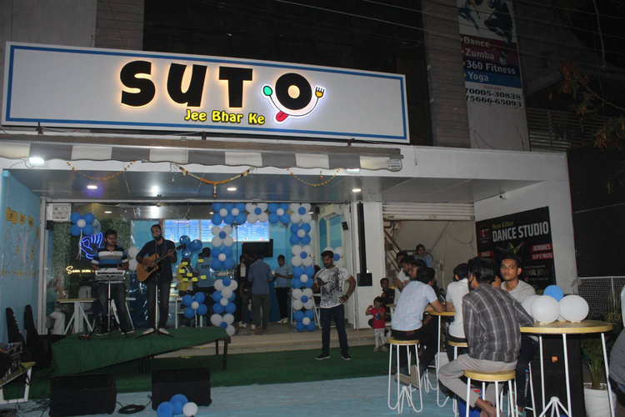
Home
Service
About Us
Contact
Best Coffee Franchise in India
Looking for the Best Coffee Franchise in India? Join Suto Cafe and become part of a thriving coffee culture! Our franchise offers a proven business model, exceptional support, and high-quality coffee products that keep customers coming back. With Suto Cafe, you’ll enjoy a brand recognized for its quality and innovation, making it the perfect choice for aspiring entrepreneurs. Start your journey with us today!
https://sutocafe.com/

Slide 4



Home
Service
About Us
Contact
Our Contact
+91 7880128851
https://sutocafe.com/
franchise@sutocafe.com
SICA School Rd, AG Sector, Scheme No 54, Indore, Madhya Pradesh 452010

