Slide 1




Siddhi Matrimonials
Marriage Bureau in Delhi

Slide 2
Siddhi Matrimonials is a premier marriage bureau in Delhi, dedicated to connecting individuals seeking meaningful relationships. With a user-friendly platform, it offers a diverse array of profiles tailored to various preferences, backgrounds, and communities. The bureau emphasizes personalized matchmaking services, ensuring a thoughtful approach to finding compatible partners. Members benefit from experienced matchmakers who understand the nuances of modern relationships, providing guidance throughout the process. Whether you’re looking for traditional arrangements or contemporary matches, Siddhi Matrimonials fosters a supportive environment for successful unions, making it a trusted choice for many in Delhi and beyond. Start your journey to love today!

Slide 3
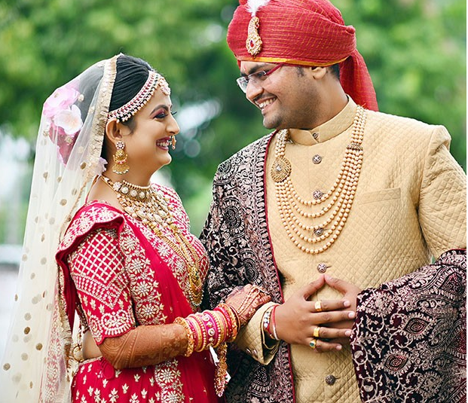
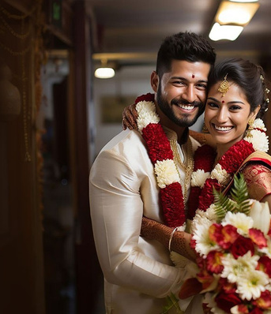
Address
1497, 2nd floor, Kotla Mubarakpur, Opp. Oncoplus Hospital, Defence Colony, Delhi – 110003
Phone - +91 78386 86853
Website - https://siddhimatrimonials.com/

Slide 4
Thank You
Visit -https://siddhimatrimonials.com/

