Slide 1


Premium Resort in Manali
Aloka Resort Manali

Slide 2


Aloka Resort is a premium resort in Manali, offering a perfect blend of luxury and nature. Guests can enjoy beautifully appointed rooms, stunning mountain views, and exceptional amenities. The resort features a serene ambiance, gourmet dining, and a variety of activities, making it an ideal destination for relaxation and adventure.

Slide 3
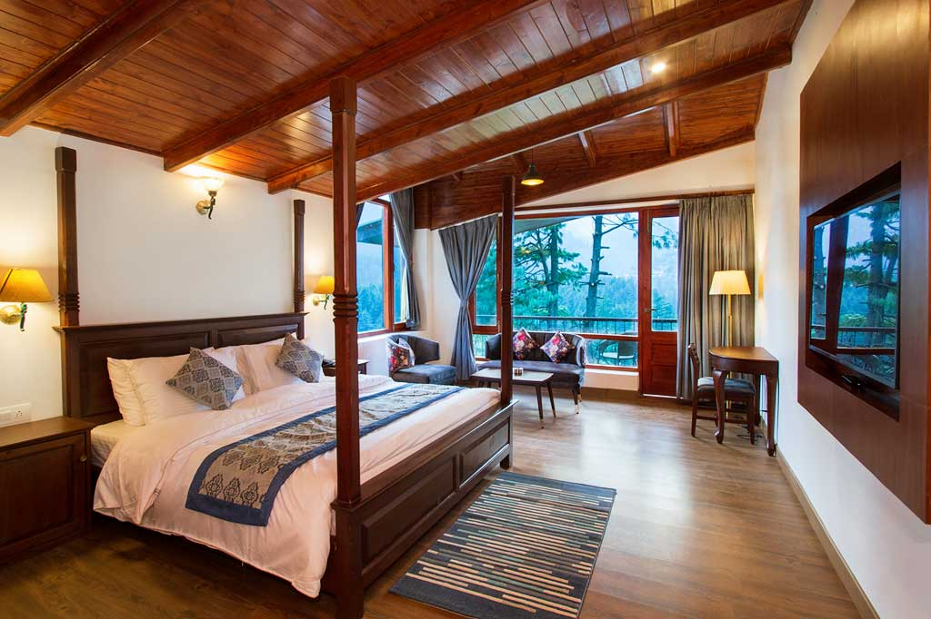

Address
Chadyari, Tehsil Manali, Distt Kullu H.P, 175131, INDIA
Phone: +91 78386-09537, +91 98160-76122
Email: alokaresortmanali@gmail.com
Website - https://alokaresortmanali.com/

Slide 4

Thank You
VISIT - HTTPS://ALOKARESORTMANALI.COM/

