Slide 1





Talbros Engineering
Heavy Duty Axle Shafts Manufacturer
https://talbrosaxles.com/products/heavy-duty-axle-shafts/

Slide 2
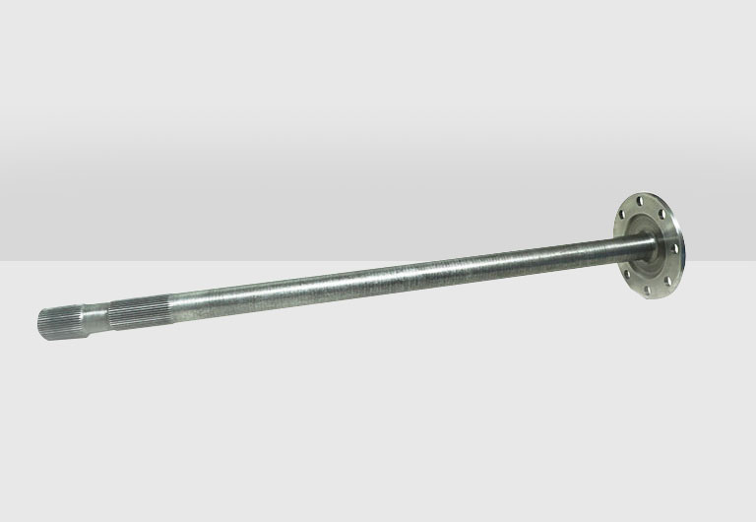
Heavy Duty Axle Shafts Manufacturer
Talbros Engineering is a leading manufacturer of heavy-duty axle shafts, engineered for exceptional strength and performance. Our high-quality products are designed to withstand the toughest conditions, making them ideal for various applications. With a commitment to innovation and reliability, we provide solutions that meet the needs of demanding industries.
For more details visit us at:-
https://talbrosaxles.com/products/heavy-duty-axle-shafts/

Slide 3
Contact Us
Talbros Engineering
Email:-contact@vinitec.in
Address:- Plot No. 74-75-76, Sector-6 Faridabad 121006 ( Haryana)
Contact No.: +91-129-4284300
Website:- https://talbrosaxles.com/products/heavy-duty-axle-shafts/

