Slide 1

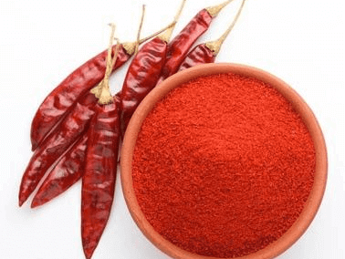
Agrocrops
Indian Dry Red Chilli Exporters
https://www.spicesindia.net/

Slide 2
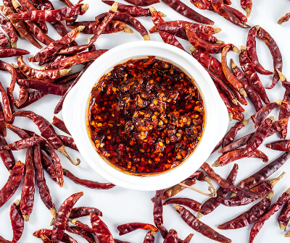
Agrocrops, the Indian Dry Red Chilli Exporters specialize in providing high-quality dry red chillies for global markets. The extensive range of the brand ensures that customers receive premium products, sourced from the finest farms. With a commitment to excellence, these exporters guarantee timely delivery and reliable service. Catering to diverse culinary needs, they maintain stringent quality standards, making them a trusted choice for buyers seeking authentic Indian spices. Partnering with Indian Dry Red Chilli Exporters means securing the best for your spice requirements.
https://www.spicesindia.net/

Slide 3

Address
Address- D.No 25-16-180, 181, Mirichi Yard Road, Guntur, Andhra Pradesh, 522005
Email Us - contact@agrocrops.com
Call us - +91 97013 63424
https://www.spicesindia.net/

Slide 4
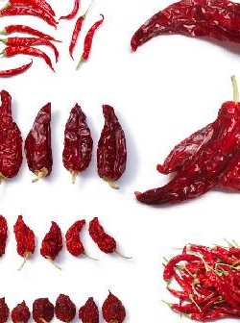
Thanks
Visit Agrocrops at -
https://www.spicesindia.net/

