Slide 1




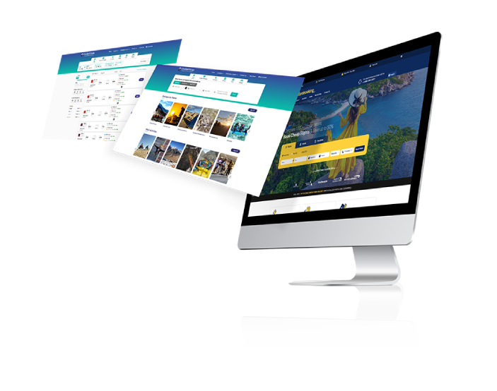
Travel Portal Software Solutions
BY TRAVIPRO
https://www.travipro.com/travel-portal-development.html

Slide 2

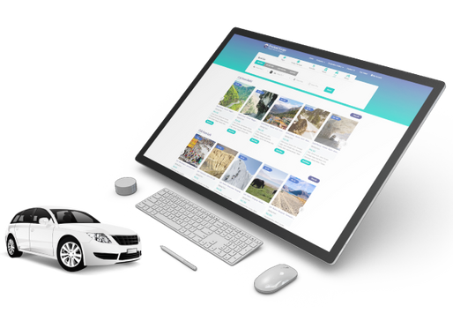
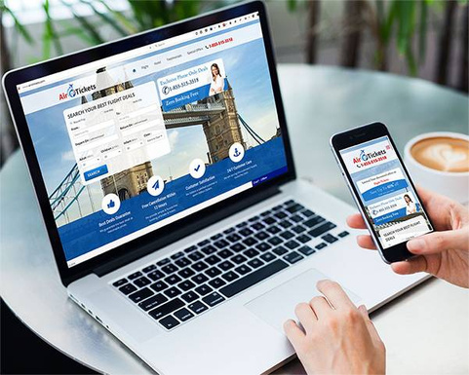
Travel Portal Software Solutions by Travipro offer comprehensive platforms that streamline booking processes and enhance user experiences in the travel industry. Designed for travel agencies, tour operators, and businesses, these solutions integrate functionalities like flight and hotel bookings, payment processing, and customer management. Travipro specializes in developing tailored travel portals that cater to specific business needs, ensuring a seamless and efficient operation. With robust features and user-friendly interfaces, Travipro's solutions empower businesses to enhance their online presence and drive customer engagement.
https://www.travipro.com/travel-portal-development.html

Slide 3




Address
B-112, Sector-64 Noida - 201301, Uttar Pradesh
Phone - +91 9560 433 318
Email - info@travipro.com
For more details, visit website - https://www.travipro.com/travel-portal-development.html

Slide 4


THANK
YOU
Visit - https://www.travipro.com/travel-portal-development.html

