Slide 1


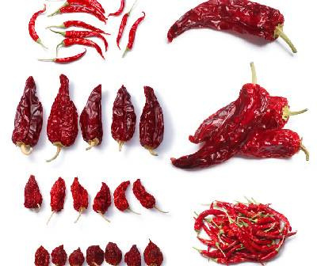
Chilli Export From India
By: Agrocrops
Visit - https://www.spicesindia.net/

Slide 2
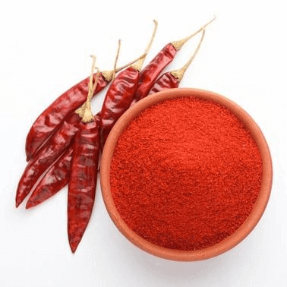
About US
Chilli Export from India has seen a significant rise in demand, and Agrocrops stands out as a leading supplier in this vibrant sector. Renowned for their commitment to quality and competitive pricing policy, Agrocrops delivers premium Indian chillies globally, ensuring freshness and superior taste. The company expertises in sourcing and exporting aligns with the highest industry standards.Trust Agrocrops to meet all the chilli export needs with excellence and reliability.

Slide 3

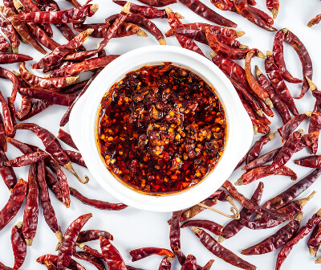

Address
D.No 25-16-180, 181, Mirichi Yard Road, Guntur, Andhra Pradesh, 522005
Phone Number: +91 9701363424
Mail: contact@agrocrops.com
Website - https://www.spicesindia.net/

Slide 4

Thank
you
Visit - https://www.spicesindia.net/

