Slide 1


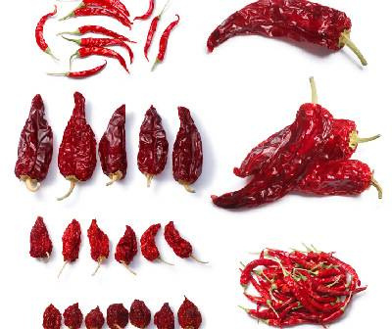
Agrocrops
Visit - https://www.spicesindia.net/

Slide 2

About US
Agrocrops is a leading exporter of high-quality chilli, known for its vibrant color, rich flavor, and distinct aroma. It has a wide variety of chillies, catering to global markets with diverse needs. Agrocrops ensures top-notch standards in cultivation, processing, and export. The company follows transparent pricing policy, reflecting global market trends while promoting fair trade practices. Chilli export from India are competitively priced, cater to diverse international demands, solidifying India's position in the global spice market.

Slide 3
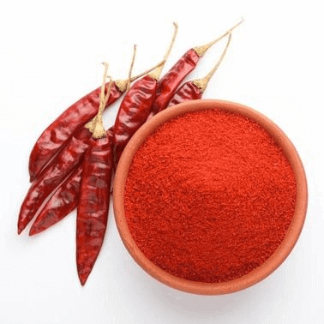







Contact US
91 9701363424
contact@agrocrops.com
https://www.spicesindia.net/
D.No 25-16-180, 181, Mirichi Yard Road, Guntur, Andhra Pradesh, 522005

Slide 4
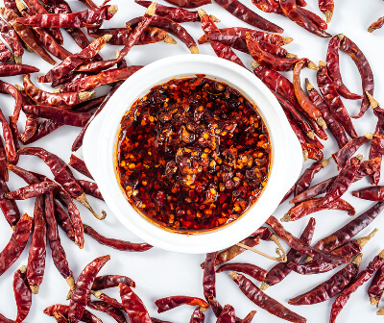
Thank
you
Visit - https://www.spicesindia.net/

