Slide 1


Aloka Resort
Manali
https://alokaresortmanali.com/
Premium Hotel in Manali

Slide 2
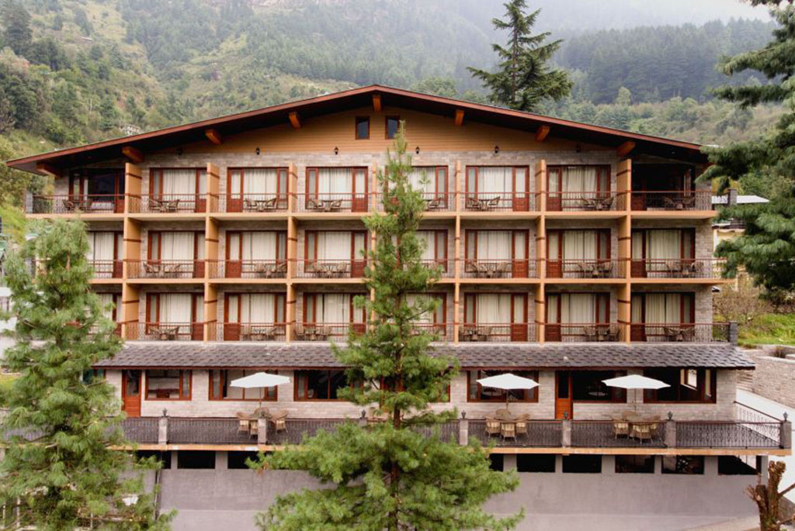

Experience unmatched extravagance at the premium hotel in Manali, Aloka Resort Manali. It offers elegant rooms with beautiful mountain views, cozy rooms, exquisite dining facilities, and modern amenities. Cuddleed in the heart of nature, it's perfect for a serene getaway, comfort, and hospitality.
About Aloka Resort Manali

Slide 3
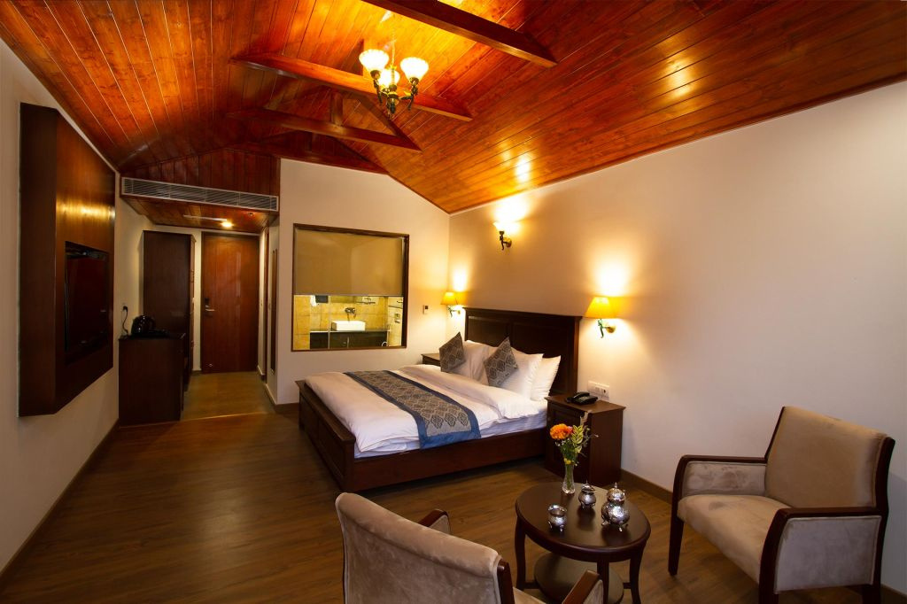
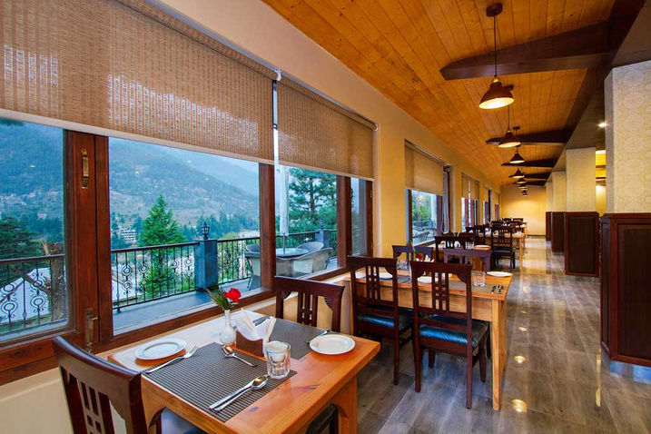
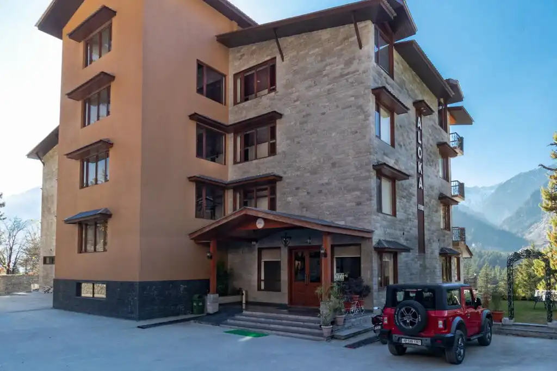

Address
Chadyari, Tehsil Manali, Distt Kullu H.P, 175131, INDIA
Phone: +91 78386-09537, +91 98160-76122
Email: alokaresortmanali@gmail.com
Website -https://alokaresortmanali.com/

Slide 4


Thanks For Watching
Visit us - https://alokaresortmanali.com/

