Slide 1
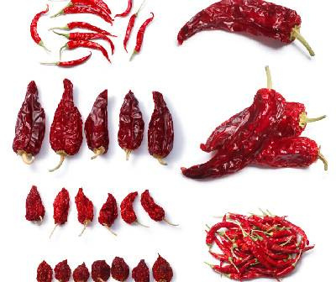

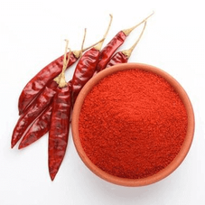
Agrocrops
Visit - https://www.spicesindia.net/

Slide 2
Agrocrops play a vital role in Chilli export from India. It is one of the leading producers and exporters of India’s diverse varieties of chillies, renowned for their distinct flavor and heat. Agrocrops provides comprehensive information about the quality and range of Indian chillies available for export, highlighting their significance in enhancing global cuisine and culinary experiences. The company offers competitive rates based on the type of chillies. Delivery policy ensures prompt dispatch and safe shipping, providing reliable service to international buyers.
Visit -https://www.spicesindia.net/

Slide 3

Address- D.No 25-16-180, 181, Mirichi Yard Road, Guntur, Andhra Pradesh, 522005
Phone Number: +91 9701363424
Mail: contact@agrocrops.com
Website - https://www.spicesindia.net/

Slide 4
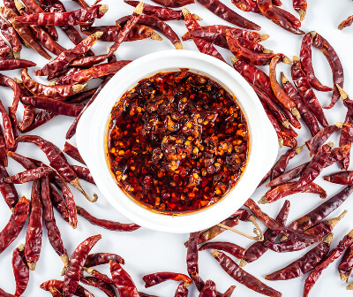
Thank You
Visit -https://www.spicesindia.net/

