Slide 1


Off-Highway Axle Shafts
by
TALBROS ENGINEERING
https://talbrosaxles.com/products/off-highway-axle-shafts/

Slide 2
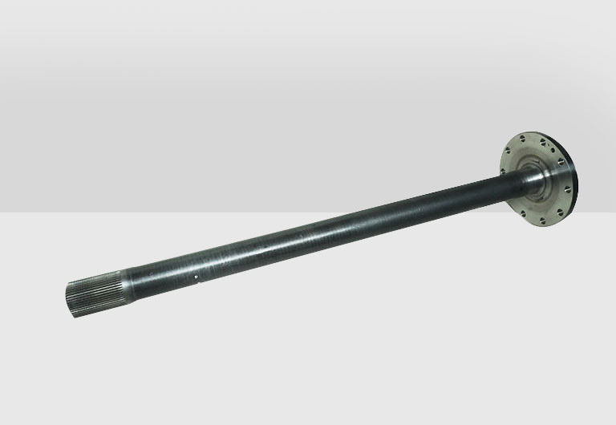
Explore Talbros Axles' Off-Highway Axle Shafts, planned for durability and high performance. Designed to handle broken ground, these axle shafts ensure solidity and efficiency for various off-highway or all terrain vehicles.
Visit -https://talbrosaxles.com/products/off-highway-axle-shafts/

Slide 3


ADDRESS
Plot No. 74-75-76, Sector-6 Faridabad 121006 ( Haryana)
Phone: 91-1294284300
Fax: 91-129-4061541
Email: axleshafts@talbrosaxles.com

Slide 4
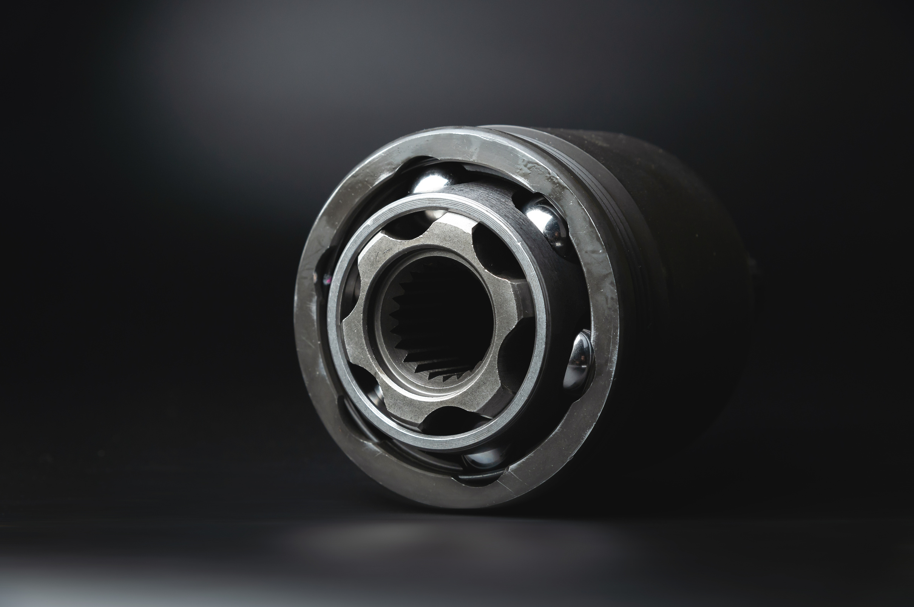
THANK YOU
Visit us - https://talbrosaxles.com/products/off-highway-axle-shafts/

