Slide 1


Aloka Resort Manali

Slide 2
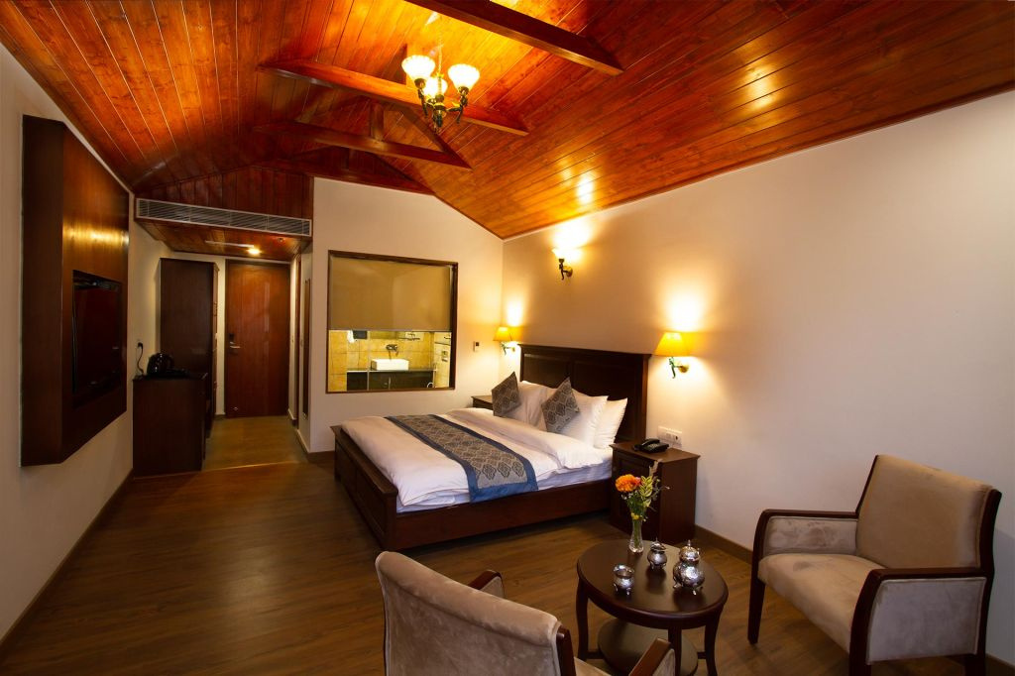

Welcome to Aloka Resort
Find unmatched luxury and comfort at Aloka Resort Manali, the perfect destination for a remarkable stay in the charming beauty of Manali.

Slide 3
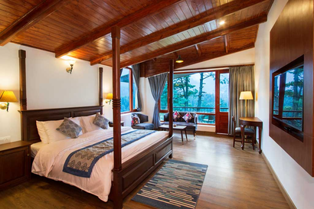
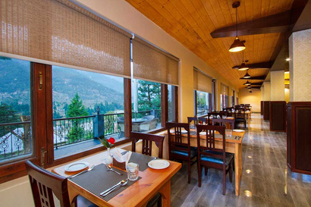
About
Experience the best trip with elegance and sophistication at Luxury Kullu Manali Resort. Cuddle up in the beautiful nature's lap, Aloka Resort offers modern amenities, breathtaking views, and flavors of Manali cuisine.
Visit - https://alokaresortmanali.com/

Slide 4

Address
Chadyari, Tehsil Manali, Distt Kullu H.P, 175131, INDIA
Phone: +91 78386-09537, +91 98160-76122
Email: alokaresortmanali@gmail.com

Slide 5

Thank You
VISIT - HTTPS://ALOKARESORTMANALI.COM/

