Slide 1





Talbros Engineering
Tandem Axle Shafts
https://talbrosaxles.com/products/tandem-axle-shafts/

Slide 2
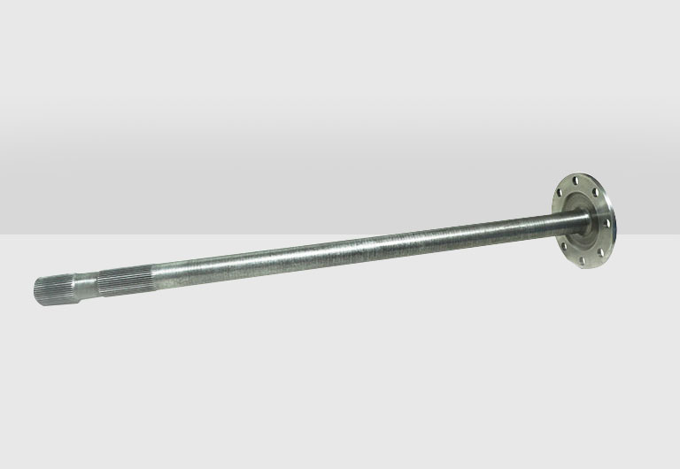
Tandem Axle Shafts
Talbros Engineering's Tandem Axle Shafts are built to last, providing robust performance for heavy-duty vehicles. These precision-engineered shafts ensure better load distribution and increased stability, making them a reliable choice for commercial and industrial use. Experience superior durability with Talbros Engineering. To know more: https://talbrosaxles.com/products/tandem-axle-shafts/
For more details visit us at:-
https://talbrosaxles.com/products/tandem-axle-shafts/

Slide 3
Contact Us
Talbros Engineering
Email:-contact@vinitec.in
Address:- Plot No. 74-75-76, Sector-6 Faridabad 121006 ( Haryana)
Contact No.: +91-129-4284300
Website:- https://talbrosaxles.com/

