Slide 1
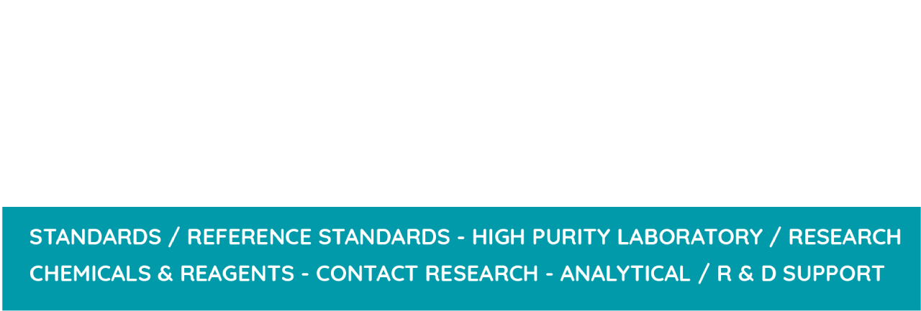
Indo Global Research Laboratory
Pharmaceutical Reference standards
Website: https://igrl.co.in/category/pharmaceutical-reference-standard/

Slide 2

Pharmaceutical Reference standards
IGRL has produced thousands of Pharmaceutical Reference Standards for quality assurance, which has benefited the pharmaceutical sector. Our exceptional quality makes it possible for you to work as precisely as possible, helping you to create safer, more effective treatments.

Slide 3
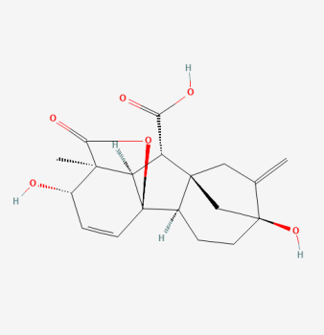
Gibberellic Acid
CODE No. :-IGRLG0007
CAS No. :77-06-5

Slide 4
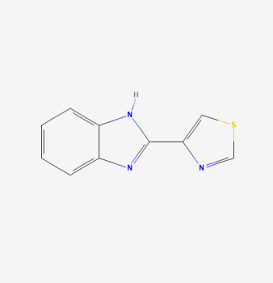
Thiabendazole
CODE No. :-IGRLT0067
CAS No. :148-79-8

Slide 5

Contact Us
Indo Global Research Laboratory
Phone No: 8920549613, 9968995868
Email Id: indoglobalresearchlaboratory@gmail.com,
indoglobal@igrl.co.in
Address: Anand Industrial Estate, Mohan Nagar, Ghaziabad, U.P.
Website: https://igrl.co.in/

